Slide 1
Data Paths
CS 2200 Fall 2023

Slide 2
Topics
Logic design review
Data paths
Finite State Machines

Slide 3
Architecture vs. Organization
Architecture – the abstraction involving programmer-visible details of a computer system, such as
Instruction set
Memory layout
Organization – the details of the implementation of a particular architecture, involving many details that are not directly visible to a programmer, such as
Register implementation
Bus structure
Memory hierarchy and bank organization
There is some gray area, just like most definitions in CS

Slide 4
The terminology!
I blithely presumed the architecture and organization terms meant the same thing they've meant for 45 years since I took this course in about 1975.
Then I asked "the Google" what it thought.
To my surprise, the first three postings I saw (quora, stackoverflow, javatpoint) had the definitions reversed or decidedly muddied. Did I fall into an alternate universe? How could it be allowed on the Internet if it's not true?
Then I looked at several academic sites which all confirmed the definition I learned 45 years ago!

Slide 5
So where do these words fit?
Architecture
ISA (instruction set architecture)
Instruction set
Machine language
Machine abstraction
Organization
Processor implementation
Microarchitecture
Perhaps think of architecture as "the API" and organization as "the code implementing the API"

Slide 6
Processor Implementation
Implementation for a given an instruction set
Instruction-set is not a description of the implementation of the processor
Contract between hardware and software
Allows a compiler writer to generate code for different high-level languages to execute on a processor that implements this contract
Can there be different implementations of the same instruction set?

Slide 7
IBM System/360: One architecture, many implementations
Model | Announced | Shipped | Scien-tific perform-ance (kIPS) | Commer-cial perform-ance (kIPS) | CPU Band-width (MB/sec) | Memory band-width (MB/sec) | Memory size (in KB)
360/30 | Apr 1964 | Jun 1965 | 10.2 | 29 | 1.3 | 0.7 | 8-64
360/40 | Apr 1964 | Apr 1965 | 40 | 75 | 3.2 | 0.8 | 16-256
360/50 | Apr 1964 | Aug 1965 | 133 | 169 | 8.0 | 2.0 | 64-512
360/20 | Nov 1964 | Mar 1966 | 2.0 | 2.6 |  |  | 4-32
360/91 | Jan 1966 | Oct 1967 | 1,900 | 1,800 | 133 | 164 | 1,024-4,096
Rasp-berry Pi 2 | 2014 | 2014 | 4,744 | 4,744 |  | 1,200 | 1,024-4,096
AMD Ryzen 3990X | 2020 | 2020 | 2,345,230 | 2,345,230 |  | 95,000 | 16,000-128,000

Slide 8
Architecture versus Implementation
Why?
Market demands (different price points)
Parallel hardware and software development
Maintain compatibility for legacy software compatibility

Slide 9
What is involved in Processor Implementation?
Organization of the electrical components (ALUs, buses, registers, etc.) commensurate with the expected price/performance characteristic of the processor.
Thermal and mechanical aspects including cooling and physical geometry for placement in mother boards.
Super Computers | Servers | Desktops & PCs | Embedded
High performance primary objective | Intermediate performance and cost | Low cost primary objective | Small size, low cost, and low power consumption primary objectives

Slide 10
Let’s Review Digital Circuits
Combinational logic
For a given set of inputs there is one unique output
Sequential logic
Circuits contain elements that remember state
Outputs depends on combinational logic that considers circuit inputs and previous state

Slide 11
Hardware resources of the datapath
Memory
ALU
Register file
Program Counter
Instruction Register

Slide 12
Logic triggering
outputs
clock
inputs
Level Triggering
Edge Triggering
Outputs change based on inputs whenever clock is high
Memory will be considered to be level triggered (for cost reasons)
Outputs change based on inputs only when clock transitions
Positive edge-triggered logic when leading edge cause triggering
Negative edge-triggered when trailing edge causes triggering

Slide 13
Registers
input
register
clock
output

Slide 14
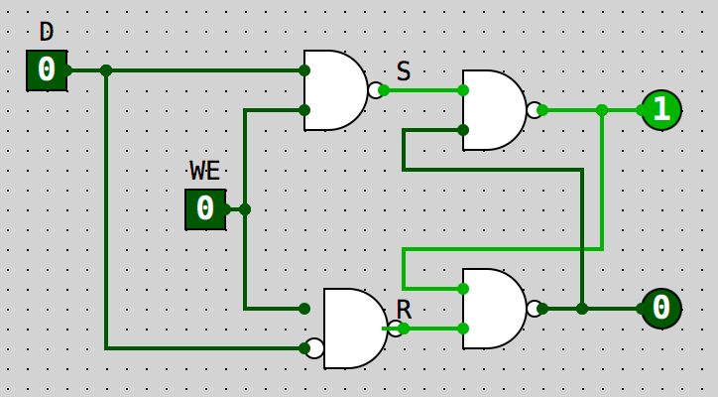
Master-Slave Flip Flop
Remember our Gated D Latch?
Master
Slave
Gated D Latch
Gated D Latch

Slide 15
Clock Edges and Master-Slave
Slave register outputs its inputs.
Master register outputs what was recorded when WE rose to 1.
Master register records what is presented on its input.
Write
Enable
Slave register records what is presented on its input.
Slave register outputs what was recorded when WE fell to 0.
Master register outputs its inputs.
Now we just connect Write Enable to the clock....

Slide 16
Registers and Clocks
Rising
edge
Falling
edge
Output stabilizes
Input stabilizes
Content of register changes to what is presented on input
(rising edge triggered)

Slide 17
How Many Clock Cycles from Input to Output?
Input
register
register
register
Output

Slide 18
Register File
Input
0
1
Address
2
Clock
.
.
.
R/W
13
14
15
Output

Slide 19
Register File
Input
0
1
Address
(0-15)
2
Clock
.
.
.
R/W (0-1)
13
14
15
Output

Slide 20
Dual Ported Register File
Input
Lets us read two registers in one clock cycle
0
1
Port 1 Address
2
.
.
.
Clock
Port 2 Address
Write
13
Dest Address
If high at end of clock, write input to the Dest address
14
15
Port 1 Output
Port 2 Output

Slide 21
Memory (DRAM)
Address
Data in
Works differently from a register
Not clocked
Level triggered logic
Why is this?
Each cell is a single transistor and capacitor (instead of 6 transistors needed for a flip-flop)
Read
Write
memory
Data out

Slide 22
A Typical ALU
A
B
Combinational circuit
Two inputs
One output
Function select which selects which functional unit is presented on the output
ALU
SEL
OUT

Slide 23
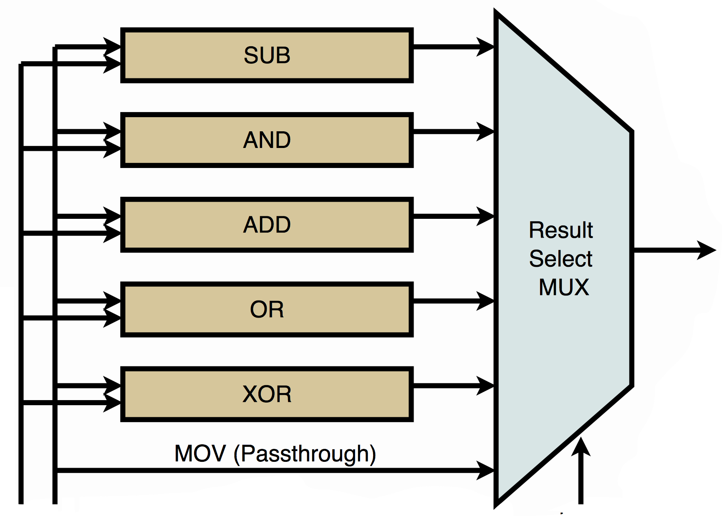
What's Inside an ALU?
How many lines needed for SEL?
How many bits wide are the data paths?
OUT
A
B
SEL
Gisselquist Technology, Inc. https://zipcpu.com/zipcpu/2017/08/11/simple-alu.html

Slide 24
Review Components
Clock signal
Register – edge triggered
Register file – read: level triggered write: edge triggered
Memory – read: level triggered (in LC-2200) write: edge triggered
ALU – Level triggered

Slide 25
Connecting the Datapath Elements
PC
Memory
Addr D_{in}
D_{out}
Register-file
IR
ALU

Slide 26
Connecting the Datapath Elements
PC
PC ➔ ADD r_{x}, r_{y}, r_{z}
r_{x} <= r_{y} + r_{z}
Work done: PC → Mem → IR → Reg File → ALU → Reg File
Memory
Addr D_{in}
Write into r_{x}
D_{out}
Register-file
IR
ADD r_{x}, r_{y}, r_{z}
Supply r_{y} and r_{z}
Bits from IR connect to 3 Reg File Inputs
ALU
Computed r_{y} + r_{z}

Slide 27
How Can We Tell?
PC
PC → Mem → IR →
Comb + Level
Reg File → ALU → Reg File
Comb + Level
Memory
Addr D_{in}
D_{out}
Register-file
Rising Edge
IR
ALU

Slide 28
Two Clock Cycles
PC → memory → IR
→ Reg File → ALU → Reg File
First clock cycle
Second clock cycle
IR Written
r_{x} Written
The wrinkle is that we read the reg file first and then write to it.

Slide 29
How Many Clock Cycles?
How many clock cycles did it take to execute PC → Mem → IR → Reg File → ALU → Reg File
One
Two
Three
Four
Five
None of the above
Today’s number is 51,112
10

Slide 30
Delays
Register Input
Setup (before clock edge)
Hold (after clock edge)
Output stable
(before it can be used)
Propagation
(wire)
ALU op
(combinational logic)
Register
ALU

Slide 31
Clock Width
PC
PC → memory → IR →
Reg File → ALU → Reg File
Memory
Addr D_{in}
D_{out}
Register-file
IR
ALU

Slide 32
Example Delay Parameters
Example 3: Given the following parameters (all in picoseconds),
determine the minimum clock width of the system.
D_{r-ouput-stable} (PC output stable) - 20 ps
D_{wire-PC-Addr} (wire delay from PC to Addr of Memory) - 250 ps
D_{mem-read} (Memory read) - 1500 ps
D_{wire-Dout-IR} (wire delay from Dout of Memory to IR) - 250 ps
D_{r-setup} (setup time for IR) - 20 ps
D_{r-hold} (hold time for IR) - 20 ps
D_{wire-IR-regfile} (wire delay from IR to Register file) - 250 ps
D_{regfile-read} (Register file read) - 500 ps
D_{wire-regfile-ALU} (wire delay from Register file to input of ALU) - 250 ps
D_{ALU-OP} (time to perform ALU operation) - 100 ps
D_{wire-ALU-regfile} (wire delay from ALU output to Register file) - 250 ps
D_{regfile-write} (time for writing into a Register file) - 500 ps

Slide 33
Question
How wide should a clock cycle be?
Ask Intel
Magic
Add all the data path delays between edge-triggered devices and then take the maximum
Set it arbitrarily and hope it works
20

Slide 34
Calculating Clock Width
PC
PC → memory → IR →
Reg File → ALU → Reg File
max(green time, blue time)
Memory
Addr D_{in}
D_{out}
Register-file
IR
Split circuits at edge-triggered devices
ALU

Slide 35
Which Are Edge-Triggered?
Level-triggered devices
Memory read (this is different from LC-3)
Register file read
ALU
Other register reads
Muxes
Decoders
Edge-triggered devices
Memory write
Register file write
Other register writes

Slide 36
Calculating Clock Minimums
PC
 | Delay (ps) | Green bracket | Blue bracket 1 | Blue brackets 2-5
D_{r-ouput-stable} | 20 | 20 |  |  | (PC output stable)
D_{wire-PC-Addr} | 250 | 250 |  |  | (wire delay from PC to Addr of Memory)
D_{mem-read} | 1500 | 1500 |  |  | (Memory read)
D_{wire-Dout-IR} | 250 | 250 |  |  | (wire delay from Dout of Memory to IR)
D_{r-setup} | 20 | 20 |  |  | (setup time for IR)
D_{r-hold} | 20 |  | 20 |  | (hold time for IR)
D_{wire-IR-regfile} | 250 |  | 250 |  | (wire delay from IR to Register file)
D_{regfile-read} | 500 |  | 500 |  | (Register file read)
D_{wire-regfile-ALU} | 250 |  | 250 |  | (wire delay from Register file to input of ALU)
D_{ALU-OP} | 100 |  | 100 |  | (time to perform ALU operation)
D_{wire-ALU-regfile} | 250 |  |  | 250 | (wire delay from ALU output to Register file)
D_{regfile-write} | 500 |  |  | 500 | (time for writing into a Register file)
Memory
Register-file
IR
ALU

Slide 37
Calculating Clock Minimums
PC
 | Delay (ps) | Green bracket | Blue bracket 1 | Blue brackets 2-5
D_{r-ouput-stable} | 20 | 20 |  |  | (PC output stable)
D_{wire-PC-Addr} | 250 | 250 |  |  | (wire delay from PC to Addr of Memory)
D_{mem-read} | 1500 | 1500 |  |  | (Memory read)
D_{wire-Dout-IR} | 250 | 250 |  |  | (wire delay from Dout of Memory to IR)
D_{r-setup} | 20 | 20 |  |  | (setup time for IR)
D_{r-hold} | 20 |  | 20 |  | (hold time for IR)
D_{wire-IR-regfile} | 250 |  | 250 |  | (wire delay from IR to Register file)
D_{regfile-read} | 500 |  | 500 |  | (Register file read)
D_{wire-regfile-ALU} | 250 |  | 250 |  | (wire delay from Register file to input of ALU)
D_{ALU-OP} | 100 |  | 100 |  | (time to perform ALU operation)
D_{wire-ALU-regfile} | 250 |  |  | 250 | (wire delay from ALU output to Register file)
D_{regfile-write} | 500 |  |  | 500 | (time for writing into a Register file)
 |  | 2040
Memory
Register-file
IR
ALU

Slide 38
Calculating Clock Minimums
PC
 | Delay (ps) | Green bracket | Blue bracket 1 | Blue brackets 2-5
D_{r-ouput-stable} | 20 | 20 |  |  | (PC output stable)
D_{wire-PC-Addr} | 250 | 250 |  |  | (wire delay from PC to Addr of Memory)
D_{mem-read} | 1500 | 1500 |  |  | (Memory read)
D_{wire-Dout-IR} | 250 | 250 |  |  | (wire delay from Dout of Memory to IR)
D_{r-setup} | 20 | 20 |  |  | (setup time for IR)
D_{r-hold} | 20 |  | 20 |  | (hold time for IR)
D_{wire-IR-regfile} | 250 |  | 250 |  | (wire delay from IR to Register file)
D_{regfile-read} | 500 |  | 500 |  | (Register file read)
D_{wire-regfile-ALU} | 250 |  | 250 |  | (wire delay from Register file to input of ALU)
D_{ALU-OP} | 100 |  | 100 |  | (time to perform ALU operation)
D_{wire-ALU-regfile} | 250 |  |  | 250 | (wire delay from ALU output to Register file)
D_{regfile-write} | 500 |  |  | 500 | (time for writing into a Register file)
 |  | 2040 | 1120 | 750
Memory
Register-file
IR
ALU

Slide 39
Calculating Clock Minimums
PC
 | Delay (ps) | Green bracket | Blue bracket 1 | Blue brackets 2-5
D_{r-ouput-stable} | 20 | 20 |  |  | (PC output stable)
D_{wire-PC-Addr} | 250 | 250 |  |  | (wire delay from PC to Addr of Memory)
D_{mem-read} | 1500 | 1500 |  |  | (Memory read)
D_{wire-Dout-IR} | 250 | 250 |  |  | (wire delay from Dout of Memory to IR)
D_{r-setup} | 20 | 20 |  |  | (setup time for IR)
D_{r-hold} | 20 |  | 20 |  | (hold time for IR)
D_{wire-IR-regfile} | 250 |  | 250 |  | (wire delay from IR to Register file)
D_{regfile-read} | 500 |  | 500 |  | (Register file read)
D_{wire-regfile-ALU} | 250 |  | 250 |  | (wire delay from Register file to input of ALU)
D_{ALU-OP} | 100 |  | 100 |  | (time to perform ALU operation)
D_{wire-ALU-regfile} | 250 |  |  | 250 | (wire delay from ALU output to Register file)
D_{regfile-write} | 500 |  |  | 500 | (time for writing into a Register file)
 |  | 2040 | 1120 | 750
 |  |  |  | 1850
Memory
Register-file
IR
ALU

Slide 40
Calculating Clock Minimums
PC
 | Delay (ps) | Green bracket | Blue bracket 1 | Blue brackets 2-5
D_{r-ouput-stable} | 20 | 20 |  |  | (PC output stable)
D_{wire-PC-Addr} | 250 | 250 |  |  | (wire delay from PC to Addr of Memory)
D_{mem-read} | 1500 | 1500 |  |  | (Memory read)
D_{wire-Dout-IR} | 250 | 250 |  |  | (wire delay from Dout of Memory to IR)
D_{r-setup} | 20 | 20 |  |  | (setup time for IR)
D_{r-hold} | 20 |  | 20 |  | (hold time for IR)
D_{wire-IR-regfile} | 250 |  | 250 |  | (wire delay from IR to Register file)
D_{regfile-read} | 500 |  | 500 |  | (Register file read)
D_{wire-regfile-ALU} | 250 |  | 250 |  | (wire delay from Register file to input of ALU)
D_{ALU-OP} | 100 |  | 100 |  | (time to perform ALU operation)
D_{wire-ALU-regfile} | 250 |  |  | 250 | (wire delay from ALU output to Register file)
D_{regfile-write} | 500 |  |  | 500 | (time for writing into a Register file)
 |  | 2040 | 1120 | 750
 |  |  |  | 1870
Memory
Register-file
IR
ALU
Clock must be >=2040 ps

Slide 41
What Other Connections Do We Need?
PC
Memory
R-type instructions (add, nand):
Opcode, x, y, z
I-type instructions (addi, lw, sw, beq):
Opcode, x, y, offset
J-type instructions (jalr):
Opcode, x, y
O-type instructions (halt):
Opcode
Addr D_{in}
D_{out}
Register-file
IR
ALU

Slide 42
Adding Connections for Our LC-2200 ISA
Memory to Reg File input for LW
Reg File output to Memory for SW
ALU Out to PC for JALR
IR to ALU In to carry offset
In other words, lots more wires
Is it possible to share some of them?

Slide 43
Towards bus-based design
In principle we must make connections between circuit elements for every instruction
Numerous connections are expensive and take up valuable space
Have a set of wires that all elements can connect to and share in order to transfer information

Slide 44
Concept of a Bus
So what's that "Drive" thing?
It's another term for a Tri-state Buffer
Functional
Unit
Functional
Unit
Functional
Unit
CLK
CLK
CLK
Drive
Drive
Drive

Slide 45
A Two-Bus Design
PC
Register-file
(DPRF)
Addr Din
memory
IR
Dout
ALU

Slide 46
Clock Cycle
PC
Register-file
(DPRF)
Addr Din
memory
IR
Dout
ALU
PC → MEM → IR

Slide 47
Clock Cycle
PC
Register-file
(DPRF)
Addr Din
memory
IR
Dout
ALU
IR → Reg File (SR1,SR2&DR) → ALU → Reg File

Slide 48
Two Busses: How Many Clock Cycles?
Using just two busses, how many clock cycles does it take to execute PC → Mem → IR → Reg File (SR1,SR2,DR) → ALU → Reg File
One
Two
Three
Four
Five
None of the above
30

Slide 49
First Clock Cycle
PC
Register-file
(DPRF)
Addr Din
memory
IR
Dout
ALU
First: PC → MEM → IR

Slide 50
Second Clock Cycle
PC
Register-file
(DPRF)
Addr Din
memory
IR
Dout
ALU
Second: IR → Reg File (SR1,SR2,DR) → ALU → Reg File

Slide 51
Single Bus Design
PC
Register-file
(DPRF)
MAR
IR
Memory
Addr Din
Dout
ALU

Slide 52
Single Bus Design w/o DPRF
PC
Register-file
(SPRF)
MAR
IR
Memory
Addr Din
A
B
Dout
ALU
This is pretty close to the LC-2200 data path we’ll be using

Slide 53
Using a single-ported register file, what is the minimum number of cycles it will take to prepare the ALU for a two-operand calculation?
0
1
2
3
Today’s number is 82,864
40

Slide 54
Topics
Logic design review
Data paths
Finite State Machines

Slide 55
Simple FSM Example
S1
S2
S3

Slide 56
Garage Door
1
0
3
up
down
2
Transition No | Current State | Clicker | D Output | U Output | Next State
0 | 0 | 0 | 0 | 0 | 0
1 | 1 | 0 | 0 | 0 | 1
2 | 0 | 1 | 0 | 1 | 1
3 | 1 | 1 | 1 | 0 | 0

Slide 57
Garage Door Controller
DownControl
Down
motor
clicker
Inputs
Outputs
Combinational logic
UpControl
Up
motor
D
Up
Q
state
Down
NextState
Q
CLK

Slide 58
Combinational Logic
DOutput = CurrentState&Clicker
UOutput = CurrentState’&Clicker
NextState = CurrentState&Clicker’ | CurrentState’&Clicker
Transition No | Current State | Clicker | D Output | U Output | Next State
0 | 0 | 0 | 0 | 0 | 0
1 | 1 | 0 | 0 | 0 | 1
2 | 0 | 1 | 0 | 1 | 1
3 | 1 | 1 | 1 | 0 | 0

Slide 59
Can We Replace Logic with a ROM?
Since we can describe combinational logic as boolean expressions, circuits, truth tables, what if we could replace a combinational circuit with a hardware truth table?
Think of a properly programmed ROM as a literal truth table describing an FSM
The address represents the input bits (including state)
The contents of the ROM produce the output bits (including the next state)
Have you seen this somewhere before?

Slide 60
From FSM to ROM
Transition No | Current State | Clicker | D Output | U Output | Next State
0 | 0 | 0 | 0 | 0 | 0
1 | 1 | 0 | 0 | 0 | 1
2 | 0 | 1 | 0 | 1 | 1
3 | 1 | 1 | 1 | 0 | 0
A
D
D
R
E
S
S
DOutput | UOutput | NextState
0 | 0 | 0
0 | 0 | 1
0 | 1 | 1
1 | 0 | 0
ROM: 3 bit word x 4 words → 3 data lines, 2 address lines
00
01
10
11

Slide 61
Replacing Discrete Logic with a ROM
ROM
DOutput | UOutput | NextState
0 | 0 | 0
0 | 0 | 1
0 | 1 | 1
1 | 0 | 0
clicker
A
D
D
R
E
S
S
00
01
10
11
Down
motor
Up
motor
Up
D
Q
state
Down
CLK
Q

Slide 62
If you have a truth table with 4 input, 3 state bits, and 4 outputs, what size ROM should you use to encode it?
2⁷ words of 7 bits
2⁴ words of 4 bits
2⁸ words of 7 bits
2⁴ words of 8 bits
4 output lines
3 next state lines
2³⁺⁴= 128 words
50

Slide 63
Checkpoint
Basics of logic design
Combinational
Sequential
Elements of the datapath
Registers & register file
ALU
Mux
Decoders
Finite state machine
Clock & clock width

Slide 64
Levels of Abstraction
Application (Algorithms expressed in High Level Language)
System software (Compiler, OS, etc.)
Computer Architecture (ISA)
Machine Organization (Datapath and Control)
Sequential and Combinational Logic Elements
Logic Gates
Transistors
Solid-State Physics (Electrons and Holes)

Slide 65
Levels of Abstraction
Application (Algorithms expressed in High Level Language)
System software (Compiler, OS, etc.)
Computer Architecture (ISA)
Machine Organization - Control
Machine Organization - Datapath
Sequential and Combinational Logic Elements
Logic Gates
Transistors
Solid-State Physics (Electrons and Holes)

Slide 66
LC-2200 Instruction Set
31
28 27
24 23
20 19
4 3
0
Opcode
Reg X
Reg Y
Unused
Reg Z
R-type instructions (add, nand):
bits 31-28: opcode
bits 27-24: reg X; bits 23-20: reg Y
bits 19-4: unused (should be all 0s); bits 3-0: reg Z
I-type instructions (addi, lw, sw, beq):
bits 31-28: opcode; bits 27-24: reg X
bits 23-20: reg Y; bits 19-0: Imm. Offset
J-type instructions (jalr):
bits 31-28: opcode; bits 27-24: reg X
bits 23-20: reg Y; bits 19-0: unused
O-type instructions (halt):
bits 31-28: opcode; bits 27-0: unused
31
28 27
24 23
20 19
0
Opcode
Reg X
Reg Y
Signed Offset
31
28 27
24 23
20 19
0
Opcode
Reg X
Reg Y
Unused
31
28 27
0
Opcode
Unused

Slide 67
Question
Addressing mode…
Refers to the kinds of opcodes supported in an architecture
Refers to the way the operands are specified in an instruction
Refers to the granularity of the memory element that can be addressed in an instruction
Refers to the datapath width
None of the above
60

Slide 68
LC-2200 Addressing Modes
31
28 27
24 23
20 19
4 3
0
Opcode
Reg X
Reg Y
Unused
Reg Z
R-type instructions (add, nand):
bits 31-28: opcode
bits 27-24: reg X; bits 23-20: reg Y
bits 19-4: unused (should be all 0s); bits 3-0: reg Z
I-type instructions (addi, lw, sw, beq):
bits 31-28: opcode; bits 27-24: reg X
bits 23-20: reg Y; bits 19-0: Imm. Offset
J-type instructions (jalr):
bits 31-28: opcode; bits 27-24: reg X
bits 23-20: reg Y; bits 19-0: unused
O-type instructions (halt):
bits 31-28: opcode; bits 27-0: unused
Register
31
28 27
24 23
20 19
0
Opcode
Reg X
Reg Y
Signed Offset
PC-Relative Base + Offset
Immediate
31
28 27
24 23
20 19
0
Opcode
Reg X
Reg Y
Unused
Register
31
28 27
0
Opcode
Unused
None

Slide 69
We’ve Got a Datapath for LC-2200!
32
LdPC
PC
LdA
A
B
LdB
LdMAR
MAR
LdIR
IR
Din
32
WrREG
WrMEM
Addr
Din
IR[31..0]
2
4
registers
memory
func
ALU:
16x
2³² x
IR[19..0]
00: ADD
regno
32 bits
32 bits
01: NAND
20
10: A
-
B
Dout
Dout
11: A + 1
sign
extend
DrPC
DrALU
DrREG
DrMEM
DrOFF
4
2
RegSel
=0?
R_{X}
00
What else do we need??
IR[27..24]
4
1
R_{Y}
01
M
U
X
4
IR[23..20]
4
regno
LdZ
Z
R_{Z}
10
IR[3..0]
1

Slide 70
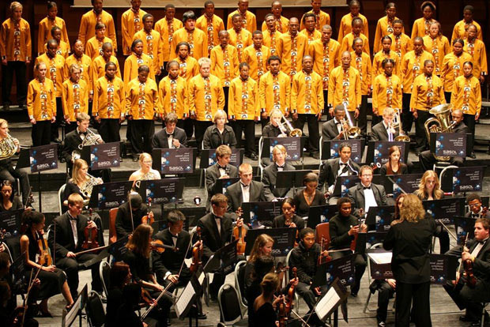

Slide 71
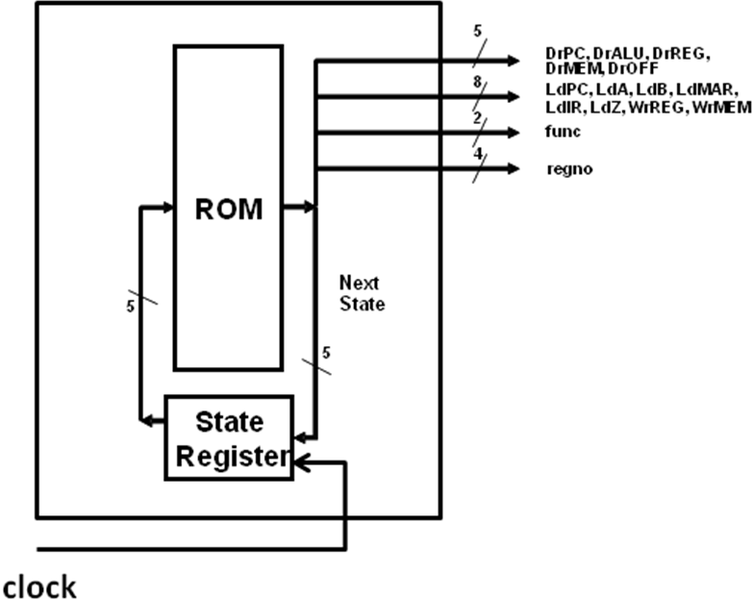
A Control Unit!
➔Datapath
2
regsel
In one clock cycle:
State reg → ROM → Drive datapath (which does the work) → Store Next State → Back to the start

Slide 72
What’s in the ROM?
 | Drive Signals |  |  |  |  | Load Signals |  |  |  |  |  | Write Signals
Current State | PC | ALU | Reg | MEM | OFF | PC | A | B | MAR | IR | Z | MEM | REG | func | RegSel
Recognize all these as the control signals to drive the datapath You will find each one on the datapath diagram!

Slide 73
The Next State is Stored in the ROM, Too!
 | Drive Signals |  |  |  |  | Load Signals |  |  |  |  |  | Write Signals
Current State | PC | ALU | Reg | MEM | OFF | PC | A | B | MAR | IR | Z | MEM | REG | func | RegSel | Next State
...
In addition to being the Current State, this is also necessarily the address of the word in the ROM

Slide 74
This Means the ROM Contents Are…
 | Drive Signals |  |  |  |  | Load Signals |  |  |  |  |  | Write Signals
Current State | PC | ALU | Reg | MEM | OFF | PC | A | B | MAR | IR | Z | MEM | REG | func | RegSel | Next State
00000 | 1 |  |  |  |  |  | 1 |  | 1 |  |  |  |  |  |  | 00001
...
Our Microprogram!
For short, we might write this microinstruction as 00000: DrPC LdMAR LdA next=00001

Slide 75
A Familiar State Diagram?
What state diagram do you think a CPU implementer might be concerned with?
Is a processor implementation a Finite State Machine?
What happens in each state?
What resources are needed to execute each instruction?
Fetch
Decode
Execute

Slide 76
Implementing the LC-2200 ISA
R-type instructions
Sequence of machine states are similar
Only the ALU op changes
J-type instructions
Straightforward
I-type instructions (LW, SW, ADDI)
Straightforward
I-type instructions (BEQ)
May take some thought…
Let’s do BEQ first

Slide 77
So How Do We Handle BEQ?
31
28 27
24 23
20 19
0
Opcode
Reg X
Reg Y
Signed Offset
BEQ has the following semantics:
if RegX == RegY then PC ← PC + 1 + signed-offset
else nothing
Read values of RegX and RegY
& perform comparision
Just exactly how do we do that?

Slide 78
Implementing BEQ
32
LdPC
PC
LdA
A
B
LdB
LdMAR
MAR
LdIR
IR
Din
32
WrREG
WrMEM
Addr
Din
IR[31..0]
2
4
registers
memory
func
ALU:
16x
2³² x
IR[19..0]
00: ADD
regno
32 bits
32 bits
01: NAND
20
10: A
-
B
Dout
Dout
11: A + 1
sign
extend
DrPC
DrALU
DrREG
DrMEM
DrOFF
Circuit for equality check
4
2
RegSel
=0?
R_{X}
00
Subtract and check for equality
IR[27..24]
4
1
R_{Y}
01
M
U
X
4
IR[23..20]
4
regno
LdZ
Z
R_{Z}
10
IR[3..0]
1

Slide 79
Implementing BEQ
32
LdPC
PC
LdA
A
B
LdB
LdMAR
MAR
LdIR
IR
Din
32
WrREG
WrMEM
Addr
Din
IR[31..0]
2
4
registers
memory
func
ALU:
16x
2³² x
IR[19..0]
00: ADD
regno
32 bits
32 bits
01: NAND
20
10: A
-
B
Dout
Dout
11: A + 1
sign
extend
DrPC
DrALU
DrREG
DrMEM
DrOFF
A 1-bit register
4
2
RegSel
=0?
R_{X}
00
Subtract and check for equality
IR[27..24]
4
1
R_{Y}
01
M
U
X
4
IR[23..20]
4
regno
LdZ
Z
R_{Z}
10
IR[3..0]
1

Slide 80
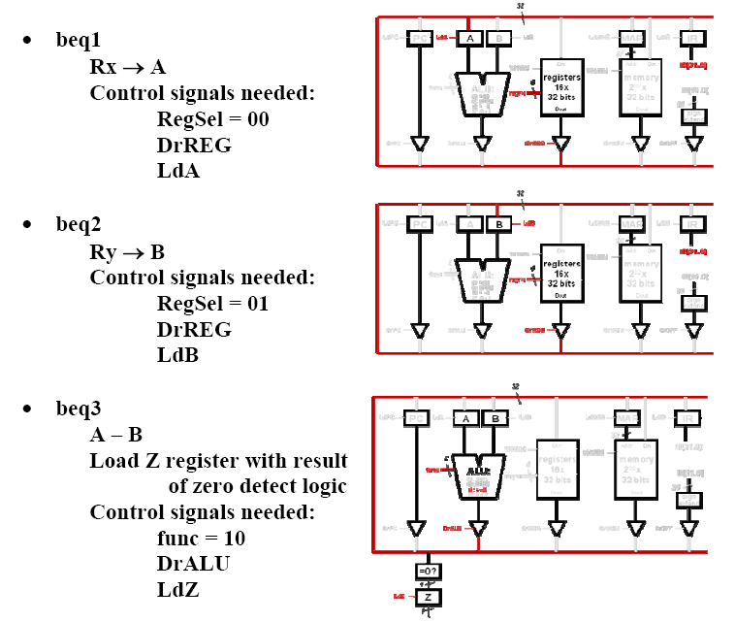
At this point, what do we know?

Slide 81
Decision Time
BEQ r_{x}, r_{y}, target PC→ <inst1>
…
target <instN>
31
28 27
24 23
20 19
0
Opcode
Reg X
Reg Y
Signed Offset
BEQ has the following semantics:
if RegX == RegY then PC ← PC + 1 + signed-offset
else nothing
i.e. go back to fetch the next instruction (e.g. <inst1>)
Need to do this if branch is taken (e.g. next instruction is <instN>

Slide 82
If Z==0 ➔ go to ifetch1
If Z==1 ➔ compute target address

Slide 83
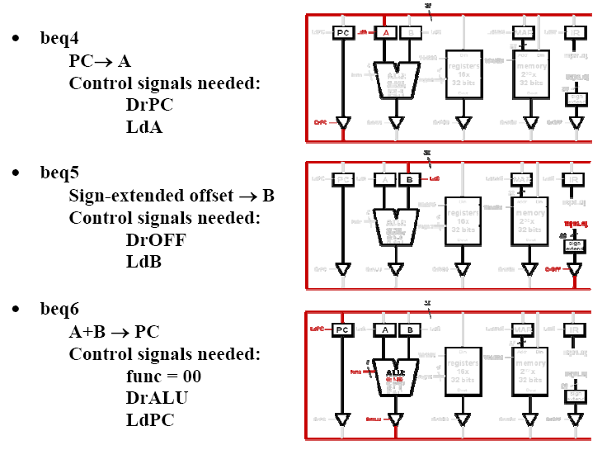
Presume we’ve taken the branch
Next state will be ifetch1

Slide 84
And We Can Fill in Most ROM Values
 | Drive Signals |  |  |  |  | Load Signals |  |  |  |  |  | Write Signals
Current State | PC | ALU | Reg | MEM | OFF | PC | A | B | MAR | IR | Z | MEM | REG | func | Reg Sel | Next State
beq1 |  |  | 1 |  |  |  | 1 |  |  |  |  |  |  |  | 00 | beq2
beq2 |  |  | 1 |  |  |  |  | 1 |  |  |  |  |  |  | 01 | beq3
beq3 |  | 1 |  |  |  |  |  |  |  |  | 1 |  |  |  | 10 | beq4 or ifetch1
beq4 | 1 |  |  |  |  |  | 1 |  |  |  |  |  |  |  |  | beq5
beq5 |  |  |  |  | 1 |  |  | 1 |  |  |  |  |  |  |  | beq6
beq6 |  | 1 |  |  |  | 1 |  |  |  |  |  |  |  | 00 |  | ifetch1

Slide 85
But How Do We Handle that Decision?
The steps in the ROM only allow for one “Next State”…
So we’re going to have to come up with some way to modify that Next State if we want to branch
What if we expand the ROM address to 6 bits so we can prepend a zero or one bit to the Next State if we want to test Z? (It doubles the ROM size, though.)
For example, if Next State was 01000, we’d output 001000 UNLESS we wanted to test Z. Then we’d either output 101000 or 001000 by sending the value in Z as the first bit of our next-state ROM address
How can we do that?

Slide 86
We Have One Additional Decision …
In a few minutes, we’re also going to have to decide how to choose the right next-state based on our opcode in IR; let’s solve that at the same time
We’ll handle that with a similar hardware mod: we’ll expand the ROM address from 6 to 10 bits
Then when we want to make that decision, we’ll use the opcode as the top 4 bits of the ROM address
That means if the opcode is 0010 and next-state is 00011, then if we use the opcode bits, we would use 00100 00011 as the next state so the microcode to execute 0010 would start at that address
This gives us a many-way branch.

Slide 87
We’re Going to Tweak the Control Unit
M
O
D
I
F
I
E
R
5
OP
4
DrPC, DrALU, DrREG,
8
DrMEM, DrOFF
Datapath
LdPC, LdA, LdB, LdMAR,
2
5
2
LdIR, LdZ, WrREG, WrMEM
func
Z
1
2
RegSel
10
ROM
24
2
M, T
T
So what are we adding?
Add a T bit to the ROM
AND the T bit and the Z reg
become the 6th address bit
Add an M bit to the ROM
AND the M bit and the OP from bits IR[31:28] to become
the 10th-7th address bits
Next
State
5
5
State
Register
clock
TM Register
Note that the TM register is a small correction to the diagram in the book.
2
2

Slide 88
What’s in MODIFIER?
Í
Value of OP in IR (4 bits) if the M-bit is set in the current state
OP
M
5
Top 5 bits of Next State
2
T
Z
Value of Z if T-bit is set in the current state
M and T from TM Register

Slide 89
Question
The two-way modifier bit T is enabled…
In the last microstate of the Fetch state
In the middle of BEQ execution after operand comparison
Always
Never
Today’s number is 95,969
70

Slide 90
Question
The Z bit input to the Modifier
M
O
D
I
F
I
E
R
5
OP
4
8
2
5
2
Z
1
2
Is always zero
Is the output of the ROM itself
Is the output of the Z register in the datapath
Is 1 if the instruction is BEQ
No clue
10
ROM
24
2
Next
State
5
5
State
Register
clock
TM Register
2
2
80

Slide 91
So We Need to Set T in the Microcode
 | Drive Signals |  |  |  |  | Load Signals |  |  |  |  |  | Write Signals
Current State | PC | ALU | Reg | MEM | OFF | PC | A | B | MAR | IR | Z | MEM | REG | func | Reg Sel | M | T | Next State
010000 |  |  | 1 |  |  |  | 1 |  |  |  |  |  |  |  | 00 |  |  | 10001
010001 |  |  | 1 |  |  |  |  | 1 |  |  |  |  |  |  | 01 |  |  | 10010
010010 |  | 1 |  |  |  |  |  |  |  |  | 1 |  |  |  | 10 |  | 1 | 10011
110011 | 1 |  |  |  |  |  | 1 |  |  |  |  |  |  |  |  |  | 1 | 10100
110100 |  |  |  |  | 1 |  |  | 1 |  |  |  |  |  |  |  |  | 1 | 10101
110101 |  | 1 |  |  |  | 1 |  |  |  |  |  |  |  | 00 |  |  |  | 00000
010011
Here we need to fill in the contents of ROM location ifetch1. Why?

Slide 92
What’s the Problem with the Z Branch?
ifetch1
000000
010011
…
Z = 0
beq1
beq2
beq3
010000
010001
010010
Z = 1
beq4
beq5
beq6
110011
110100
110101

Slide 93
An Old Microcode Trick!
We duplicate ifetch1 at the appropriate ROM address (so its clone does exactly the same thing). The clone transfers to the same next-state as the original!
ifetch1
Ifetch1-clone
000000
010011
…
Z = 0
beq1
beq2
beq3
010000
010001
010010
Z = 1
beq4
beq5
beq6
110011
110100
110101

Slide 94
FETCH macro-state
Need to do
We need to send PC to the memory
Read the memory contents
Bring the memory contents read into the IR
Increment the PC
(And decode the opcode by branching to the right execution state)
Microstates to accomplish
ifetch1
PC → MAR
ifetch2
MEM[MAR] → IR
ifetch3
PC → A
ifetch4
A+1 → PC

Slide 95
FETCH state (Simplifying)
ifetch1
PC → MAR
PC → A
ifetch2
MEM[MAR] → IR
ifetch3
A+1 → PC

Slide 96
FETCH state: Adding in control signals
ifetch1
PC → MAR
PC → A
Control signals needed:
DrPC
LdMAR
LdA
ifetch2
MEM[MAR] → IR
Control signals needed:
DrMEM
LdIR
ifetch3
A+1 → PC
Control signals needed:
func = 11
DrALU
LdPC

Slide 97
Before ifetch1
32
LdPC
PC
LdA
A
B
LdB
LdMAR
MAR
LdIR
IR
Din
32
WrREG
WrMEM
Addr
Din
IR[31..0]
2
4
registers
memory
func
ALU:
16x
2³² x
IR[19..0]
00: ADD
regno
32 bits
32 bits
01: NAND
20
10: A
-
B
Dout
Dout
11: A + 1
sign
extend
DrPC
DrALU
DrREG
DrMEM
DrOFF
4
2
RegSel
=0?
IR[27..24]
R_{X}
00
4
M
U
X
1
IR[23..20]
R_{Y}
01
4
regno
LdZ
Z
R_{Z}
4
10
IR[3..0]
1

Slide 98
Implementing ifetch1 (end of clock 1)
32
LdPC
PC
LdA
A
B
LdB
LdMAR
MAR
LdIR
IR
PC
PC
Din
32
WrREG
WrMEM
Addr
Din
IR[31..0]
2
4
registers
memory
func
ALU:
16x
2³² x
IR[19..0]
00: ADD
regno
32 bits
32 bits
01: NAND
20
10: A
-
B
Dout
Dout
11: A + 1
sign
PC+B
extend
M[PC]
DrPC
DrALU
DrREG
DrMEM
DrOFF
PC
DrPC
LdMAR
LdA
Others=0
4
2
RegSel
=0?
IR[27..24]
R_{X}
00
4
M
U
X
1
IR[23..20]
R_{Y}
01
4
regno
LdZ
Z
R_{Z}
4
10
IR[3..0]
1

Slide 99
Implementing ifetch2 (end of clock 2)
32
LdPC
PC
LdA
A
B
LdB
LdMAR
MAR
LdIR
IR
PC
PC
M[PC]
Din
32
WrREG
WrMEM
Addr
Din
IR[31..0]
2
4
registers
memory
func
ALU:
16x
2³² x
IR[19..0]
00: ADD
regno
32 bits
32 bits
01: NAND
20
10: A
-
B
Dout
Dout
11: A + 1
sign
PC+B
extend
DrPC
DrALU
DrREG
DrMEM
DrOFF
M[PC]
DrMem
LdIR
Others=0
4
2
RegSel
=0?
IR[27..24]
R_{X}
00
4
M
U
X
1
IR[23..20]
R_{Y}
01
4
regno
LdZ
Z
R_{Z}
4
10
IR[3..0]
1

Slide 100
Implementing ifetch3 (end of clock 3)
32
LdPC
PC
LdA
A
B
LdB
LdMAR
MAR
LdIR
IR
PC+1
PC
PC
M[PC]
Din
32
WrREG
WrMEM
Addr
Din
IR[31..0]
2
4
registers
memory
func
=11
ALU:
16x
2³² x
IR[19..0]
00: ADD
regno
32 bits
32 bits
01: NAND
20
10: A
-
B
Dout
Dout
11: A + 1
sign
PC+1
extend
M[PC]
DrPC
DrALU
DrREG
DrMEM
DrOFF
PC+1
func=11
DrALU
LdPC
Others=0
4
2
RegSel
=0?
IR[27..24]
R_{X}
00
4
M
U
X
1
IR[23..20]
R_{Y}
01
4
regno
LdZ
Z
R_{Z}
4
10
IR[3..0]
1

Slide 101
DECODE State
Fetch
R-Type
O-Type
I-Type
J-Type
Decode is a MULTIWAY branch!
We can’t encode this in Next State!
Actually, we can, given the modification to the Control Unit we made for BEQ

Slide 102
DECODE State
Fetch
R-Type
O-Type
I-Type
J-Type
We’ll use the same trick we used for BEQ
On the last step of ifetch, we’ll set the top 4 bits of our ROM address to the opcode that’s in IR[31:28]!
OK. How do we do that?

Slide 103
We’re Going to Tweak the Control Unit
M
O
D
I
F
I
E
R
5
OP
4
DrPC, DrALU, DrREG,
8
DrMEM, DrOFF
Datapath
LdPC, LdA, LdB, LdMAR,
2
5
2
LdIR, LdZ, WrREG, WrMEM
func
Z
1
2
RegSel
10
ROM
24
2
M, T
T
So what are we adding?
Add a T bit to the ROM
AND the T bit and the Z reg
become the 6th address bit
Add an M bit to the ROM
AND the M bit and the OP from bits IR[31:28] to become
the 10th-7th address bits
Next
State
5
5
State
Register
clock
TM Register
2
2

Slide 104
Let’s Encode the 3 ifetch States
 | Drive Signals |  |  |  |  | Load Signals |  |  |  |  |  | Write Signals
Current State | PC | ALU | Reg | MEM | OFF | PC | A | B | MAR | IR | Z | MEM | REG | func | Reg Sel | M | T | Next State
0000000000 | 1 |  |  |  |  |  | 1 |  | 1 |  |  |  |  |  |  |  |  | 00001
0000000001 |  |  |  | 1 |  |  |  |  |  | 1 |  |  |  |  |  |  |  | 00010
0000000010 |  | 1 |  |  |  | 1 |  |  |  |  |  |  |  | 11 |  |  |  | 10000
1
So how do we make it take that multi-way branch?
Just set the M bit at 0000000010!

Slide 105
Next State After the Last State of Fetch
Fetch
ADD
HALT
0000
0
10000
NAND
JALR
0111
0
10000
. . . . . .
0001
0
10000
0110
0
10000
Base address from ROM in Next State

Slide 106
ROM Contents
ifetch1
ifetch2
ifetch3
add1
add2
add3
beq1
beq2
beq3
ifetch1-clone
ROM
. . . .
. . . .
ADD
NAND
…
Base
Start of exec sequence
beq4

Slide 107
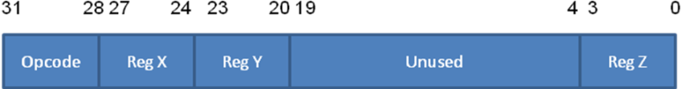
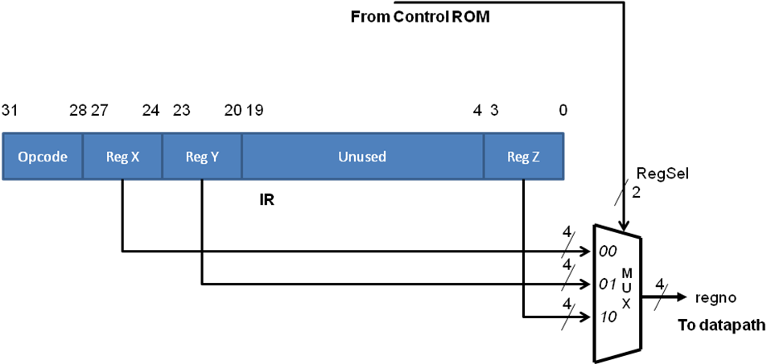
EXECUTE state: ADD instruction
R_{X} ← R_{Y} + R_{Z}

Slide 108
EXECUTE state: ADD instruction
add1
Ry → A
Control signals needed:
RegSel = 01
DrREG
LdA
add2
Rz → B
Control signals needed:
RegSel = 10
DrREG
LdB
add3
A+B → Rx
Control signals needed:
func = 00
DrALU
RegSel = 00
WrREG
ifetch1
.
.
.
add1
add2
add3

Slide 109
EXECUTE state: ADD instruction
What must be changed in ADD to implement NAND?

Slide 110
EXECUTE state: JALR instruction
JALR instruction does the following:
R_{Y} ← PC + 1
PC ← R_{X}
jalr1
PC → Ry
Control signals needed:
DrPC
RegSel = 01
WrREG
jalr2
Rx → PC
Control signals needed:
RegSel = 00
DrREG
LdPC

Slide 111
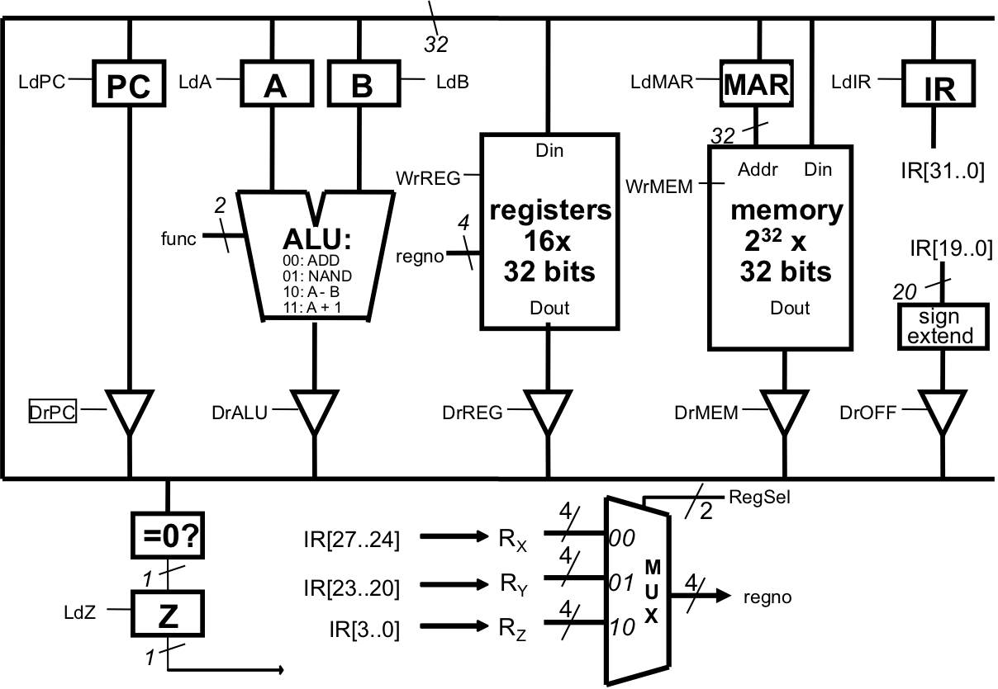
When all of the control signals are zero in the LC-2200 datapath, what value is being presented by the ALU to DrALU?
A+B
The value of one of the registers
Zero
Floating
90

Slide 112
Alternative Style of Control Unit Design
A number of different approaches may be used to implement the Control Unit

Slide 113
Microprogrammed Control
As presented our design works
Problem: Slower than a combinational logic control
Solution: Pre-fetch the next microinstruction
Problem: Too much memory required
Solution: OR the opcode with the next state value 10000 instead of pre-pending it
Solution: Use more than one ROM
One set of ROMs for which state comes next
One for what the control outputs should be in the state
Solution: More sophisticated Decode/BEQ logic

Slide 114
3-ROM Microsequencer
Other control signals
(DrREG, DRMEM, LdPC, etc.)
Main
ROM
2^{m} entries
19
m
Opcode ROM
2^{n} m-bit entries
(n is # of opcode bits)
S0
IR[31:28]
S1
m-bit state register
00
m
m
MUX
01
10
m
Z ROM 2 entries
Z

Slide 115
Space/Time Tradeoff
Flat ROM
More space (since we increased the ROM by a factor of 32 for the occasional address modifiers, but have extra ROM space)
Faster since only one ROM access in each microinstruction
Micro sequencer (3-ROM control unit)
Less space (main ROM much smaller than Flat ROM)
Slower since additional ROM access in every clock cycle

Slide 116
Hardwired Control
State machine can be represented as sequential logic truth table
Thus the state machine can be implemented using normal combinational logic or FPGA

Slide 117
Control Regime | Pros | Cons | Comment | When to use | Examples
Micro-programmed | Simplicity, maintainability, flexibility Rapid prototyping | Potential for space and time inefficiency | Space inefficiency may be mitigated with vertical microcode Time inefficiency may be mitigated with prefetching | For complex instructions, and for quick non-pipelined prototyping of architectures | PDP 11 series, IBM 360 and 370 series, Motorola 68000, complex instructions in Intel x86 architecture
Hardwired | Amenable for pipelined implementation Potential for higher performance | Potentially harder to change the design Longer design time | Maintainability can be increased with the use of structured hardware such as PLAs and FPGAs | For High performance pipelined implementation of architectures | Most modern processors including Intel x86 series, IBM PowerPC, MIPS

Slide 118
3.6.3 Choosing between the two control design styles
Control Regime | Microprogrammed | Hardwired
Pros | Simplicity, maintainability, flexibility. Rapid prototyping | Amenable for pipelined implementation. Potential for higher performance
Cons | Potential for space and time inefficiency | Potentially harder to change the design. Longer design time
Comments | Space inefficiency may be mitigated with vertical microcode. Time inefficiency may be mitigated with pre-fetching | Maintainability can be increased with the use of structured hardware such as PLAs and FPGAs
When to use | For complex instructions, and for quick non-pipelined prototyping of architectures | For high performance pipelined implementation of architectures
Examples | PDP 11 series, IBM 360 and 370 series, Motorola 68000, complex instructions in Intel x86 architecture | Most modern processors including Intel Pentium series, IBM PowerPC, MIPS

